Slide 1
GENETIC LGORITHMS

Slide 2
Contents
Introduction
Components
GA cycle of reproduction
Crossover
Mutation
Genetic Programming
Models of Evolution and Learning
Applications.

Slide 3
Introduction
A genetic algorithm is an adaptive heuristic search algorithm inspired by "Darwin's theory of evolution in Nature."
It is used to solve optimization problems in machine learning.
It is one of the important algorithms as it helps solve complex problems that would take a long time to solve.
Genetic Algorithms are being widely used in different real-world applications.
For example, Designing electronic circuits, code-breaking, image processing, and artificial creativity.

Slide 4
Introduction
Genetic algorithms provide an approach to learning that is based loosely on simulated evolution.
Hypotheses are often described by bit strings whose interpretation depends on the application,
Hypotheses may also be described by symbolic expressions or even computer programs.
The search for an appropriate hypothesis begins with a population, or collection, of initial hypotheses.
Members of the current population give rise to the next generation population by means of operations such as random mutation and crossover, which are patterned after processes in biological evolution.
At each step, the hypotheses in the current population are evaluated relative to a given measure of fitness, with the most fit hypotheses selected probabilistically as seeds for producing the next generation.

Slide 5
Introduction
Genetic algorithms have been applied successfully to a variety of learning tasks and to other optimization problems.
For example, they have been used to learn collections of rules for robot control and to optimize the topology and learning parameters for artificial neural networks.
The popularity of GAS is motivated by a number of factors including:
Evolution is known to be a successful, robust method for adaptation within biological systems.
GAs can search spaces of hypotheses containing complex interacting parts, where the impact of each part on overall hypothesis fitness may be difficult to model.
Genetic algorithms are easily parallelized and can take advantage of the decreasing costs of powerful computer hardware.

Slide 6
Components of GA
Standard genetic algorithms involve four basic functions: selection, crossover, mutation, and elitism.
Selection -
Individuals in a population are selected for reproduction according to their fitness values.
In biology, fitness is the number of offspring that survive to reproduction.
Crossover -
Selected parents reproduce the offspring by performing a crossover operation on the chromosomes (cut and splice pieces of one parent to those of another).
In nature, crossover implies two parents exchange parts of their corresponding chromosomes.
In genetic algorithms, crossover operation makes two strings swap their partial strings.

Slide 7
Components of GA
Mutation -
Mutation is an insurance policy against lost bits.
It works on the level of string bits by randomly altering a bit value.
With small probability, it randomly selects one bit on a chromosome then inverts the bit from 0 to 1 or vice versa.
The operation is designed to prevent GA from premature termination, namely converging to a solution too early.
Elitism -
The selection and crossover operators will tend to ensure that the best genetic material and the components of the fittest chromosomes will be carried forward to the next generation.
However, the probabilistic nature of these operators implies that this will not always be the case.
An elitist strategy is therefore required to ensure that the best genetic material will not be lost by chance.
This is accomplished by always carrying forward the best chromosome from one generation to the next.

Slide 8
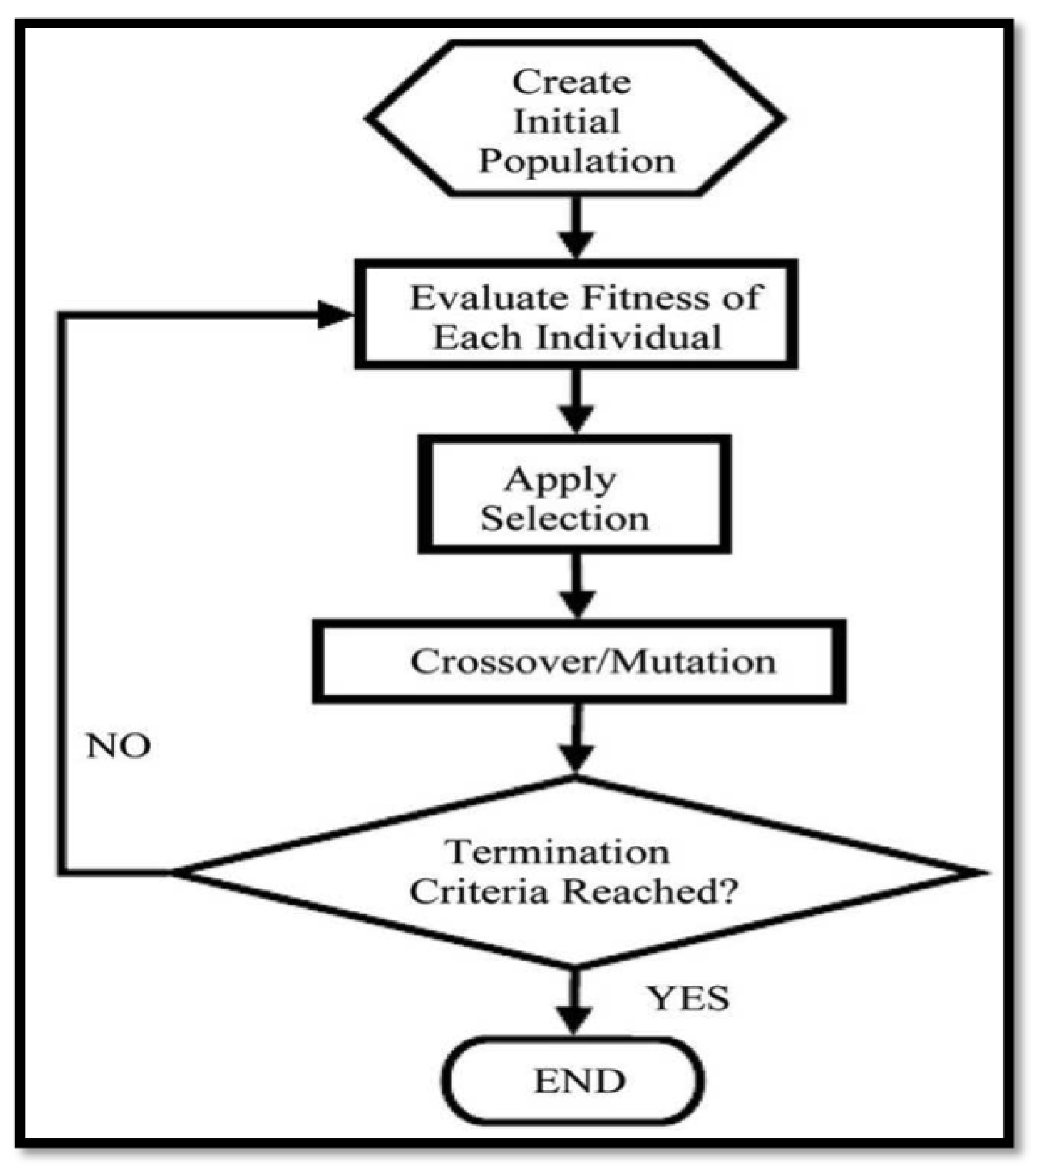
Introduction

Slide 9
MAIN Genetic Operators
The generation of successors in a GA is determined by a set of operators that recombine and mutate selected members of the current population.
These operators correspond to idealized versions of the genetic operations found in biological evolution.
The two most common operators are:
Crossover
Mutation.

Slide 10
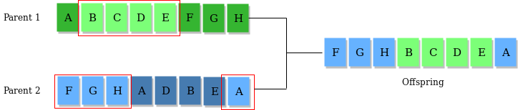
Genetic Operators
Once the initial generation is created, the algorithm evolves the generation using following operators
Selection Operator:
The idea is to give preference to the individuals with good fitness scores and allow them to pass their genes to successive generations.
Crossover Operator:
This represents mating between individuals.
Two individuals are selected using selection operator and crossover sites are chosen randomly.
Then the genes at these crossover sites are exchanged thus creating a completely new individual (offspring). Example:

Slide 11
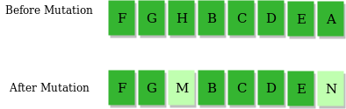
Genetic Operators
Mutation Operator:
The key idea is to insert random genes in offspring to maintain the diversity in the population to avoid premature convergence. For example –

Slide 12
How the Genetic Algorithm Works
The algorithm begins by creating a random initial population.
The algorithm then creates a sequence of new populations. At each step, the algorithm uses the individuals in the current generation to create the next population. To create the new population, the algorithm performs the following steps:
Scores each member of the current population by computing its fitness value. These values are called the raw fitness scores.
Scales the raw fitness scores to convert them into a more usable range of values. These scaled values are called expectation values.
Selects members, called parents, based on their expectation.
Some of the individuals in the current population that have lower fitness are chosen as elite. These elite individuals are passed to the next population.
Produces children from the parents. Children are produced either by making random changes to a single parent—mutation—or by combining the vector entries of a pair of parents—crossover.
Replaces the current population with the children to form the next generation.
The algorithm stops when one of the stopping criteria is met.
The algorithm takes modified steps for linear and integer constraints.
The algorithm is further modified for nonlinear constraints.

Slide 13
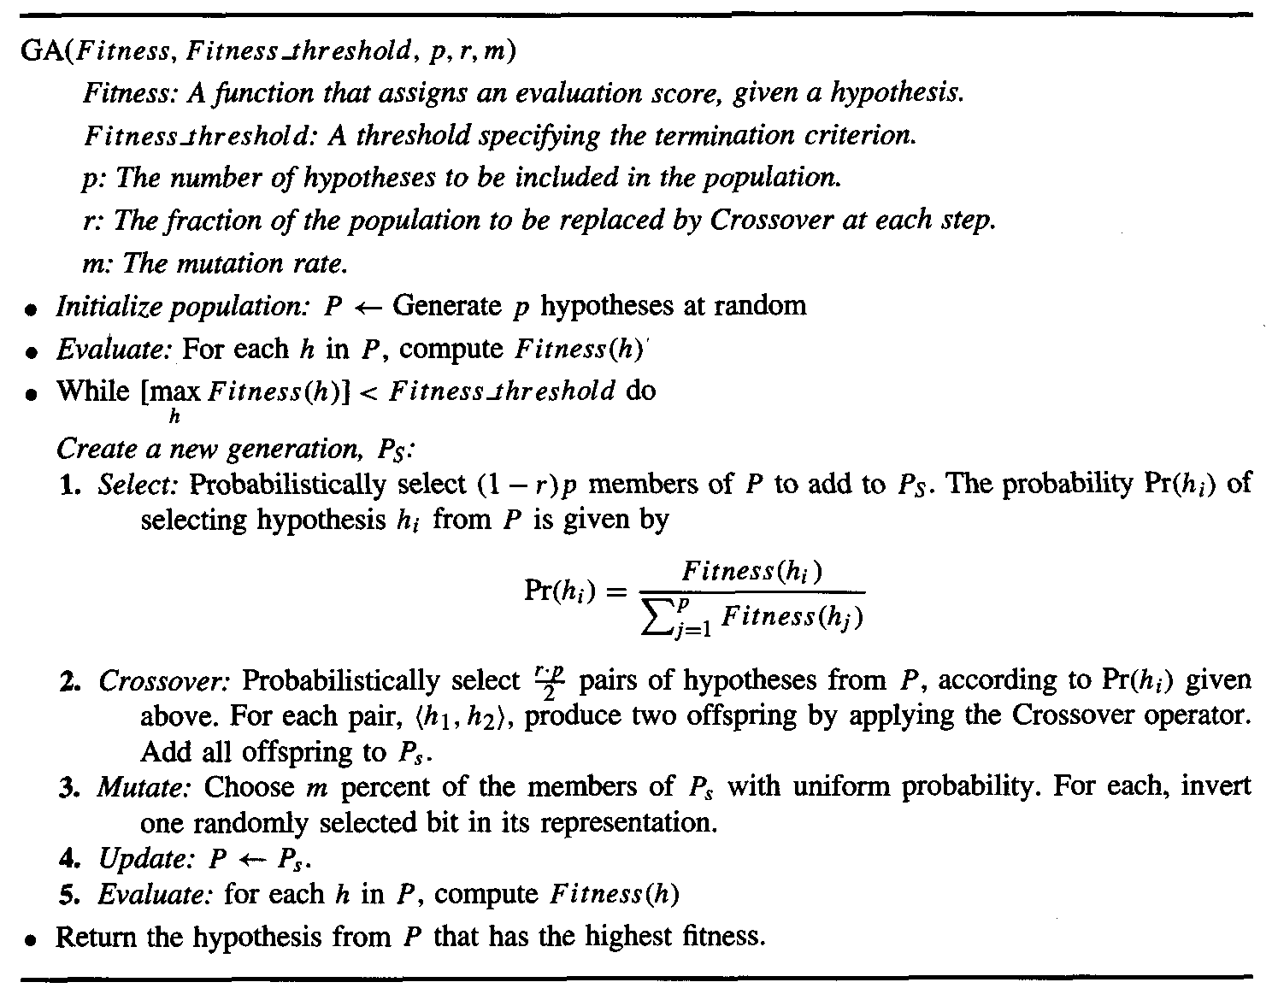
How the Genetic Algorithm Works

Slide 14
Fitness Score in GA
A Fitness Score is given to each individual which shows the ability of an individual to “compete”.
The individual having optimal fitness score (or near optimal) are sought.
The GAs maintains the population of n individuals (chromosome/solutions) along with their fitness scores.
The individuals having better fitness scores are given more chance to reproduce than others.
The individuals with better fitness scores are selected who mate and produce better offspring by combining chromosomes of parents.
The population size is static so the room has to be created for new arrivals.
So, some individuals die and get replaced by new arrivals eventually creating new generation when all the mating opportunity of the old population is exhausted.
It is hoped that over successive generations better solutions will arrive while least fit die.

Slide 15
Representing hypothesis in GA
Hypotheses in GAS are often represented by bit strings, so that they can be easily manipulated by genetic operators such as mutation and crossover.
The hypotheses represented by these bit strings can be quite complex.
Consider the attribute Outlook, which can take on any of the three values Sunny, Overcast, or Rain.
One obvious way to represent a constraint on Outlook is to use a bit string of length three, in which each bit position corresponds to one of its three possible values.
Placing a 1 in some position indicates that the attribute is allowed to take on the corresponding value.
For example, the string 010 represents the constraint that Outlook must take on the second of these values, , or Outlook = Overcast.

Slide 16
Representing hypothesis in GA
Similarly, the string 011 represents the more general constraint that allows two possible values:
Outlook = Overcast ∨ Rain
Note: 111 represents the most general possible constraint, indicating that we don't care which of its possible values th e attribute takes on.
Conjunctions of constraints on multiple attributes can easily be represented by concatenating the corresponding bit strings.
Consider a second attribute, Wind, that can take on the value Strong or Weak. A rule precondition such as:
(Outlook = Overcast ∨ Rain) ∧ (Wind = Strong)
Can then be represented by the following bit string of length five: Outlook Wind
011 10

Slide 17
Representing hypothesis in GA
Rule post conditions (such as Play Tennis = yes) can be represented in a similar fashion.
Thus, an entire rule can be described by concatenating the bit strings describing the rule preconditions, together with the bit string describing the rule postcondition.
For example, the rule
IF Wind = Strong THEN Play Tennis = yes
would be represented by the string
Outlook Wind Play Tennis
1 1 1 1 0 1 0
Allocate just one bit to the Play Tennis post condition to indicate whether the value is Yes or No):
Outlook Wind Play Tennis
1 1 1 1 0 1 (1 for yes o for no)

Slide 18
Representing hypothesis in GA
The crossover operator produces two new offspring from two parent strings, by copying selected bits from each parent.
The bit at position i in each offspring is copied from the bit at position i in one of the two parents.
The choice of which parent contributes the bit for position i is determined by an additional string called the crossover mask.

Slide 19
Representing hypothesis in GA
Single-point crossover operator
This offspring takes its first five bits from the first parent and its remaining six bits from the second parent, because the crossover mask 11111000000 specifies these choices for each of the bit positions.
The second offspring uses the same crossover mask, but switches the roles of the two parents.
Therefore, it contains the bits that were not used by the first offspring.
In single-point crossover, the crossover mask is always constructed so that it begins with a string containing n contiguous Is, followed by the necessary number of 0s to complete the string.
This results in offspring in which the first n bits are contributed by one parent and the remaining bits by the second parent.

Slide 20
Representing hypothesis in GA
Single-point crossover operator
This offspring takes its first five bits from the first parent and its remaining six bits from the second parent, because the crossover mask 11111000000 specifies these choices for each of the bit positions.
The second offspring uses the same crossover mask, but switches the roles of the two parents.
Therefore, it contains the bits that were not used by the first offspring.
In single-point crossover, the crossover mask is always constructed so that it begins with a string containing n contiguous Is, followed by the necessary number of 0s to complete the string.
This results in offspring in which the first n bits are contributed by one parent and the remaining bits by the second parent.

Slide 21
Representing hypothesis in GA
In two-point crossover,-offspring are created by substituting intermediate segments of one parent into the middle of the second parent string.
Put another way, the crossover mask is a string beginning with no zeros, followed by a contiguous string of nl ones, followed by the necessary number of zeros to complete the string.
Each time the two-point crossover operator is applied, a mask is generated by randomly choosing the integers no and nl.
For instance, in the example shown figure offspring are created using a mask for which no = 2 and n1 = 5.
Again, the two offspring are created by switching the roles played by the two parents.

Slide 22
Representing hypothesis in GA
Uniform crossover combines bits sampled uniformly from the two parents.
In this case the crossover mask is generated as a random bit string with each bit chosen at random and independent of the others.
In addition to recombination operators that produce offspring by combining parts of two parents, a second type of operator produces offspring from a single parent.
In particular, the mutation operator produces small random changes to the bit string by choosing a single bit at random, then changing its value.

Slide 23
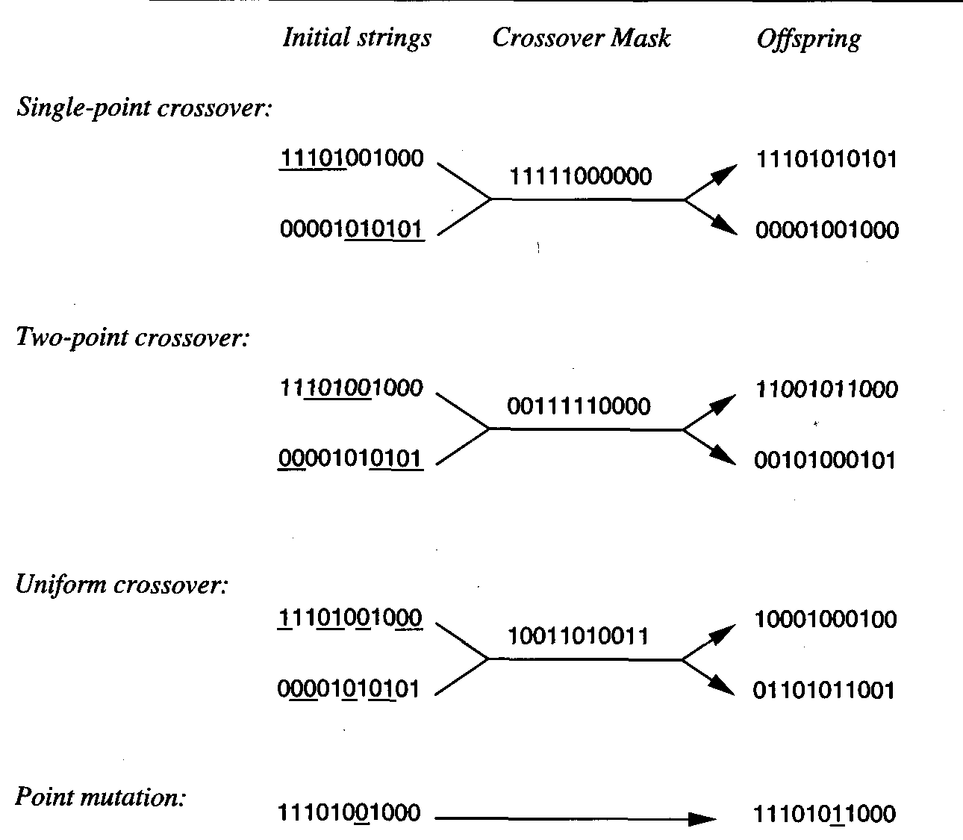
Crossover

Slide 24
GA summary
The whole algorithm can be summarized as –
1) Randomly initialize populations p 2) Determine fitness of population 3) Until convergence repeat: a) Select parents from population b) Crossover and generate new population c) Perform mutation on new population d) Calculate fitness for new population

Slide 25
GA summary
Example problem and solution using Genetic Algorithms
Given a target string, the goal is to produce target string starting from a random string of the same length.
In the implementation, following analogies are made –Characters A-Z, a-z, 0-9, and other special symbols are considered as genes
A string generated by these characters is considered as chromosome/solution/Individual
Fitness score is the number of characters which differ from characters in target string at a particular index.
So individual having lower fitness value is given more preference.
Program link:https://www.geeksforgeeks.org/genetic-algorithms/

Slide 26
GA summary
Generation: 1 String: tO{"-?=jH[k8=B4]Oe@} Fitness: 18 Generation: 2 String: tO{"-?=jH[k8=B4]Oe@} Fitness: 18 Generation: 3 String: .#lRWf9k_Ifslw #O$k_ Fitness: 17 Generation: 4 String: .-1Rq?9mHqk3Wo]3rek_ Fitness: 16 Generation: 5 String: .-1Rq?9mHqk3Wo]3rek_ Fitness: 16 Generation: 6 String: A#ldW) #lIkslw cVek) Fitness: 14 Generation: 7 String: A#ldW) #lIkslw cVek) Fitness: 14 Generation: 8 String: (, o x _x%Rs=, 6Peek3 Fitness: 13 . . . Generation: 29 String: I lope Geeks#o, Geeks Fitness: 3 Generation: 30 String: I loMe GeeksfoBGeeks Fitness: 2 Generation: 31 String: I love Geeksfo0Geeks Fitness: 1 Generation: 32 String: I love Geeksfo0Geeks Fitness: 1 Generation: 33 String: I love Geeksfo0Geeks Fitness: 1 Generation: 34 String: I love GeeksforGeeks Fitness: 0
Note: Red Characters are matching characters with output string and
black are differ than output string is to be generated.

Slide 27
Difference between Genetic Algorithms and Traditional Algorithms
A search space is the set of all possible solutions to the problem. In the traditional algorithm, only one set of solutions is maintained, whereas, in a genetic algorithm, several sets of solutions in search space can be used.
Traditional algorithms need more information in order to perform a search, whereas genetic algorithms need only one objective function to calculate the fitness of an individual.
Traditional Algorithms cannot work parallelly, whereas genetic Algorithms can work parallelly (calculating the fitness of the individualities are independent).
One big difference in genetic Algorithms is that rather of operating directly on seeker results, inheritable algorithms operate on their representations (or rendering), frequently appertained to as chromosomes.
One of the big differences between traditional algorithm and genetic algorithm is that it does not directly operate on candidate solutions.
Traditional Algorithms can only generate one result in the end, whereas Genetic Algorithms can generate multiple optimal results from different generations.
The traditional algorithm is not more likely to generate optimal results, whereas Genetic algorithms do not guarantee to generate optimal global results, but also there is a great possibility of getting the optimal result for a problem as it uses genetic operators such as Crossover and Mutation.
Traditional algorithms are deterministic in nature, whereas Genetic algorithms are probabilistic and stochastic in nature.

Slide 28
Limitations of Genetic Algorithms
Genetic algorithms are not efficient algorithms for solving simple problems.
It does not guarantee the quality of the final solution to a problem.
Repetitive calculation of fitness values may generate some computational challenges.

Slide 29
Advantages of Genetic Algorithm
The parallel capabilities of genetic algorithms are best.
It helps in optimizing various problems such as discrete functions, multi-objective problems, and continuous functions.
It provides a solution for a problem that improves over time.
A genetic algorithm does not need derivative information.

Slide 30
applications of Genetic Algorithm
Optimization −
Genetic Algorithms are most commonly used in optimization problems wherein we have to maximize or minimize a given objective function value under a given set of constraints.
The approach to solve Optimization problems has been highlighted throughout the tutorial.
Economics −
GAs are also used to characterize various economic models like the cobweb model, game theory equilibrium resolution, asset pricing, etc.
Neural Networks −
GAs are also used to train neural networks, particularly recurrent neural networks.
Parallelization −
GAs also have very good parallel capabilities, and prove to be very effective means in solving certain problems, and also provide a good area for research.
Image Processing −
GAs are used for various digital image processing (DIP) tasks as well like dense pixel matching.
Vehicle routing problems −
With multiple soft time windows, multiple depots and a heterogeneous fleet.

Slide 31
applications of Genetic Algorithm
Scheduling applications −
GAs are used to solve various scheduling problems as well, particularly the time tabling problem.
Machine Learning −
Genetics based machine learning (GBML) is a niche area in machine learning.
Robot Trajectory Generation −
GAs have been used to plan the path which a robot arm takes by moving from one point to another.
Parametric Design of Aircraft −
GAs have been used to design aircrafts by varying the parameters and evolving better solutions.
DNA Analysis −
GAs have been used to determine the structure of DNA using spectrometric data about the sample.
Multimodal Optimization −
GAs are obviously very good approaches for multimodal optimization in which we have to find multiple optimum solutions.
Traveling salesman problem and its applications −
GAs have been used to solve the TSP, which is a well-known combinatorial problem using novel crossover and packing strategies.

Slide 32
HYPOTHESIS SPACE SEARCH
GA is employ a randomized beam search method to seek a maximally fit hypothesis.
This search is quite different from that of other learning methods we have considered in this book.
To contrast the hypothesis space search of GAs with that of neural network BACKPROPAGATIUON.
For example the gradient descent search in BACKPROPAGTION moves smoothly from one hypothesis to a new hypothesis that is very similar.
In contrast, the GA search can move much more abruptly, replacing a parent hypothesis by an offspring that may be radically different from the parent.
Note the GA search is therefore less likely to fall into the same kind of local minima that can plague gradient descent methods.

Slide 33
HYPOTHESIS SPACE SEARCH
One practical difficulty in some GA applications is the problem of crowding.
Crowding is a phenomenon in which some individual that is more highly fit than others in the population quickly reproduces.
Therefore copies of this individual and very similar individuals take over a large fraction of the population.
The negative impact of crowding is that it reduces the diversity of the population, thereby slowing further progress by the GA.
One approach is to alter the selection function, using criteria such as tournament selection or rank selection in place of fitness proportionate roulette wheel selection.

Slide 34
HYPOTHESIS SPACE SEARCH
A related strategy is "fitness sharing," in which the measured fitness of an individual is reduced by the presence of other, similar individuals in the population.
A third approach is to restrict the kinds of individuals allowed to recombine to form offspring.
For example, by allowing only the most similar individuals to recombine, we can encourage the formation of clusters of similar individuals, or multiple "subspecies" within the population.
A related approach is to spatially distribute individuals and allow only nearby individuals to recombine.
Many of these techniques are inspired by the analogy to biological evolution.

Slide 35
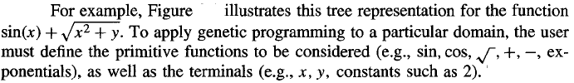
GENETIC PROGRAMMING
Genetic programming (GP) is a form of evolutionary computation in which the individuals in the evolving population are computer programs rather than bit strings.
Representing Programs:
Programs manipulated by a GP are typically represented by trees corresponding to the parse tree of the program.
Each function call is represented by a node in the tree, and the arguments to the function are given by its descendant nodes.

Slide 36
GENETIC PROGRAMMING
The genetic programming algorithm then uses an evolutionary search to explore the vast space of programs that can be described using these primitives.
As in a genetic algorithm, the prototypical genetic programming algorithm maintains a population of individuals (in this case, program trees).
On each iteration it produces a new generation of individuals using selection, crossover, and mutation.
The fitness of a given individual program in the population is typically determined by executing the program on a set of training data.
Crossover operations are performed by replacing a randomly chosen subtree of one parent program by a subtree from the other parent program.

Slide 37
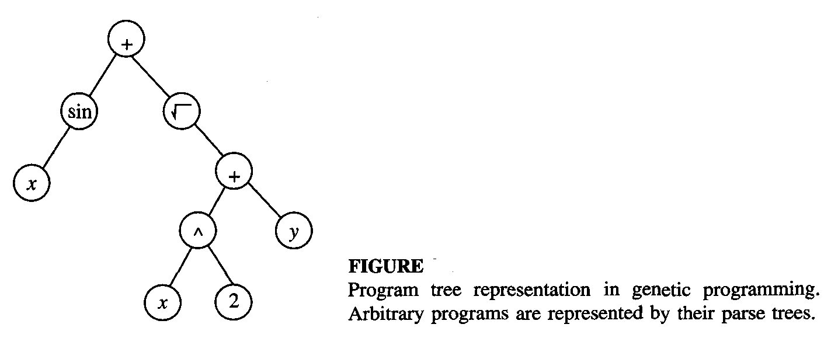
GENETIC PROGRAMMING

Slide 38
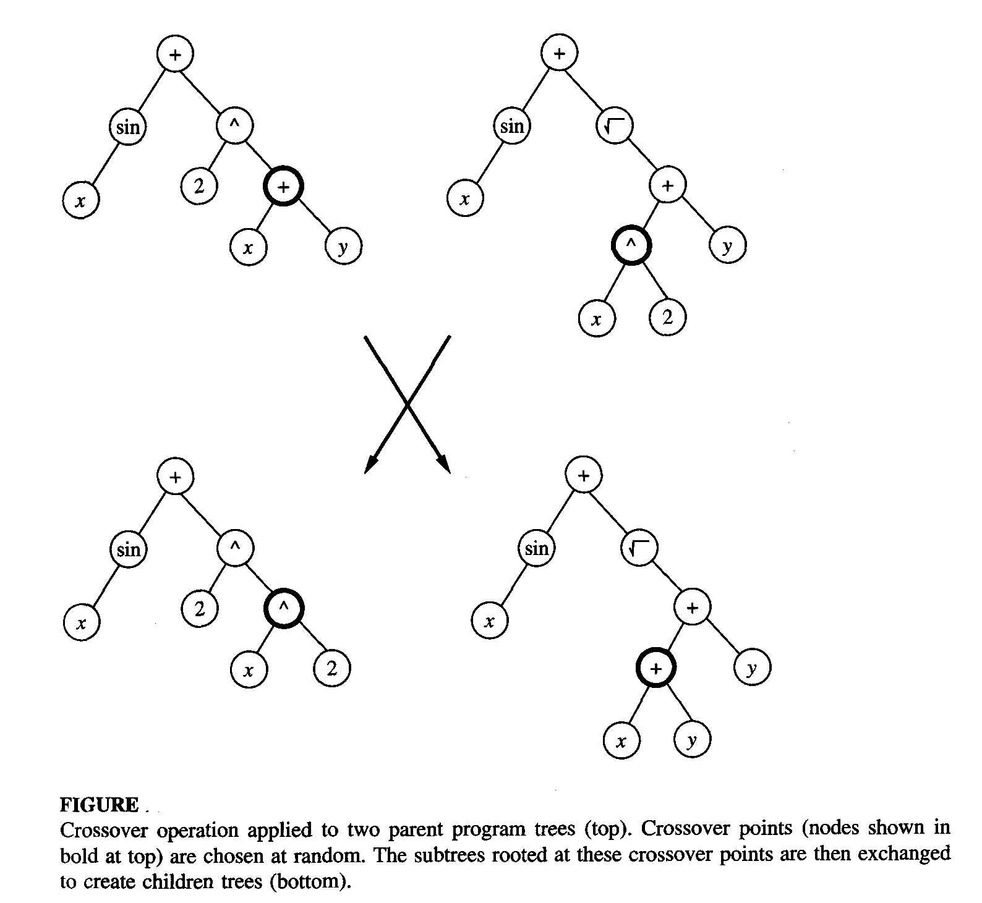
GENETIC PROGRAMMING

Slide 39
Remarks on Genetic Programming
As illustrated in the above example, genetic programming extends genetic algorithms to the evolution of complete computer programs.
Despite the huge size of the hypothesis space it must search, genetic programming has been demonstrated to produce intriguing results in a number of applications.
In most cases, the performance of genetic programming depends crucially on the choice of representation and on the choice of fitness function.
For this reason, an active area of current research is aimed at the automatic discovery and incorporation of subroutines that improve on the original set of primitive functions,
Thereby allowing the system to dynamically alter the primitives from which it constructs individuals

